Slide 1

DATA INSIGHT FUNDAMENTALS
SETTING THE STAGE
data-action-lab.com

Slide 2
OUTLINE
Data, M.L., and A.I. in the News
Data 101 – Basic Data Concepts
Some Practical Definitions
Workflows and Pipelines – the Process of Working with Data
Models and Systems Thinking
Ethical Considerations and Best Practices

Slide 3
Headlines
Robots are better than doctors at diagnosing some cancers, major study finds. [reported on by The Telegraph, UK, 29-05-2018]
MRNet: Deep-learning-assisted diagnosis for knee magnetic resonance imaging [Stanford ML Group]
Data scientists find connections between birth month and health [Columbia University Medical Centre]
We tried teaching an AI to write Christmas movie plots. Hilarity ensued. Eventually. [MIT Technical Review, 21-12-2018]

Slide 4
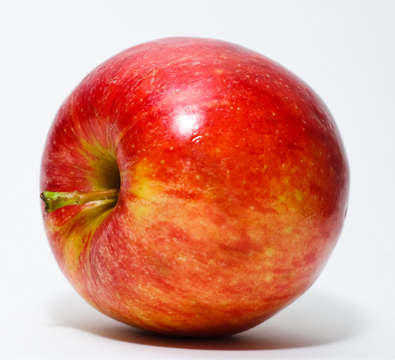
Objects and Attributes
Object: apple
Shape: spherical
Colour: red
Function: food
Location: fridge
Owner: Jen
Remember: a person or an object is not simply the sum of its attributes!

Slide 5
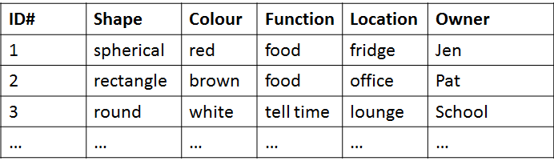
From Attributes to Datasets
Attributes are fields (or columns) in a database; objects are instances (or rows)
Objects are described by their feature vector, the collection of attributes associated with value(s) of interest

Slide 6
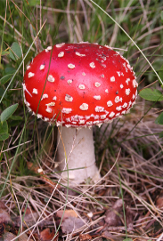
Poisonous Mushrooms Dataset
[https://archive.ics.uci.edu/ml/datasets/Mushroom]
Amanita muscaria
Habitat: woods Gill Size: narrow Odor: none Spores: white
Classification problem: Is Amanita muscaria edible, or poisonous?

Slide 7
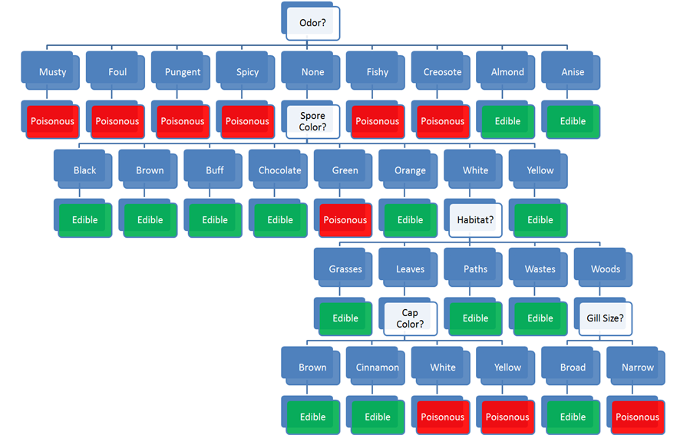
Habitat: woods
Gill Size: narrow
Odor: none
Spores: white
Classification problem: Is Amanita muscaria edible or poisonous?

Slide 8
Habitat: woods
Gill Size: narrow
Odor: none
Spores: white
Classification problem: Is Amanita muscaria edible or poisonous?

Slide 9
Asking the Right Questions
Data science is really about asking and answering questions:
Analytics: “How many clicks did this link get?”
Data Science: “Based on this user’s previous purchasing history, can I predict what links they will click on the next time they access the site?”
Data mining/science models are usually predictive (not explanatory): they show connections, but don't reveal why these exist.
Warning: not every situation calls for data science, artificial intelligence, machine learning, or analytics.

Slide 10
Data Science/MACHINE LEARNING/A.I. Tasks
Classification and class probability estimation: which clients are likely to be repeat customers?
Clustering: do customers form natural groups?
Association rule discovery: what books are commonly purchased together?
Others:
profiling and behaviour description; link prediction; value estimation (how much is a client likely to spend in a restaurant); similarity matching (which prospective clients are similar to a company's best clients?); data reduction; influence/causal modeling, etc.

Slide 11
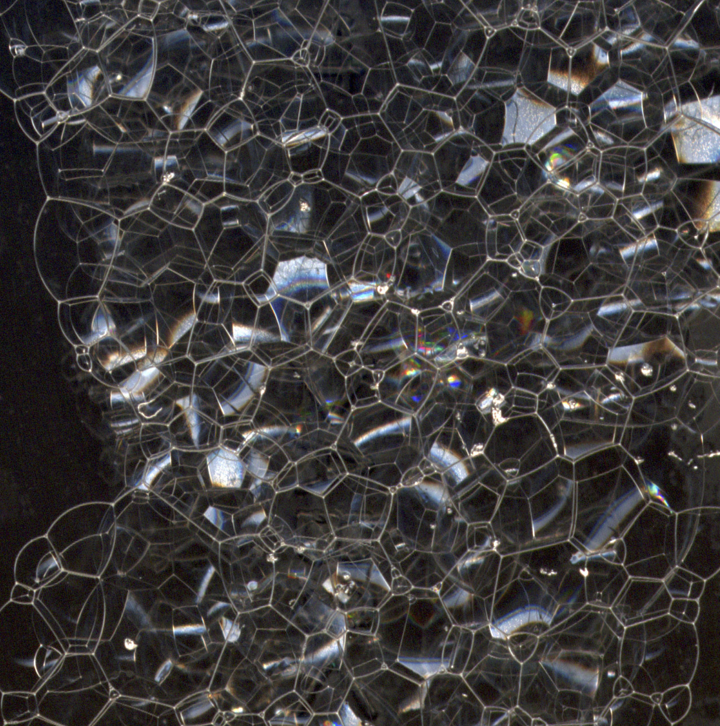
What is DATA ANALYSIS?
Finding patterns in data
Using data to do something (answer a question, help decision-making, predict the future, draw a conclusion)
Creating models of your data
Describing or explaining your situation (your system)
(Testing (scientific) hypotheses?)
(Carrying out calculations on data?)
The more complicated the pattern, the more complicated the analysis

Slide 12
What is Data Science?
Data science is the collection of processes by which we extract useful and actionable insights from data.
T. Kwartler (paraphrased)
Data science is the working intersection of statistics, engineering, computer science, domain expertise, and “hacking.” It involves two main thrusts: analytics (counting things) and inventing new techniques to draw insights from data.
H. Mason (paraphrased)

Slide 13
What is MACHINE LEARNING?
Starting around the 1940s researchers began in earnest to teach machines how to learn
The goal of machine learning was to create machines that could learn and adapt and respond to novel situations
A wide variety of techniques, accompanied by a great deal of theoretical underpinning, was created in an effort to achieve this goal

Slide 14
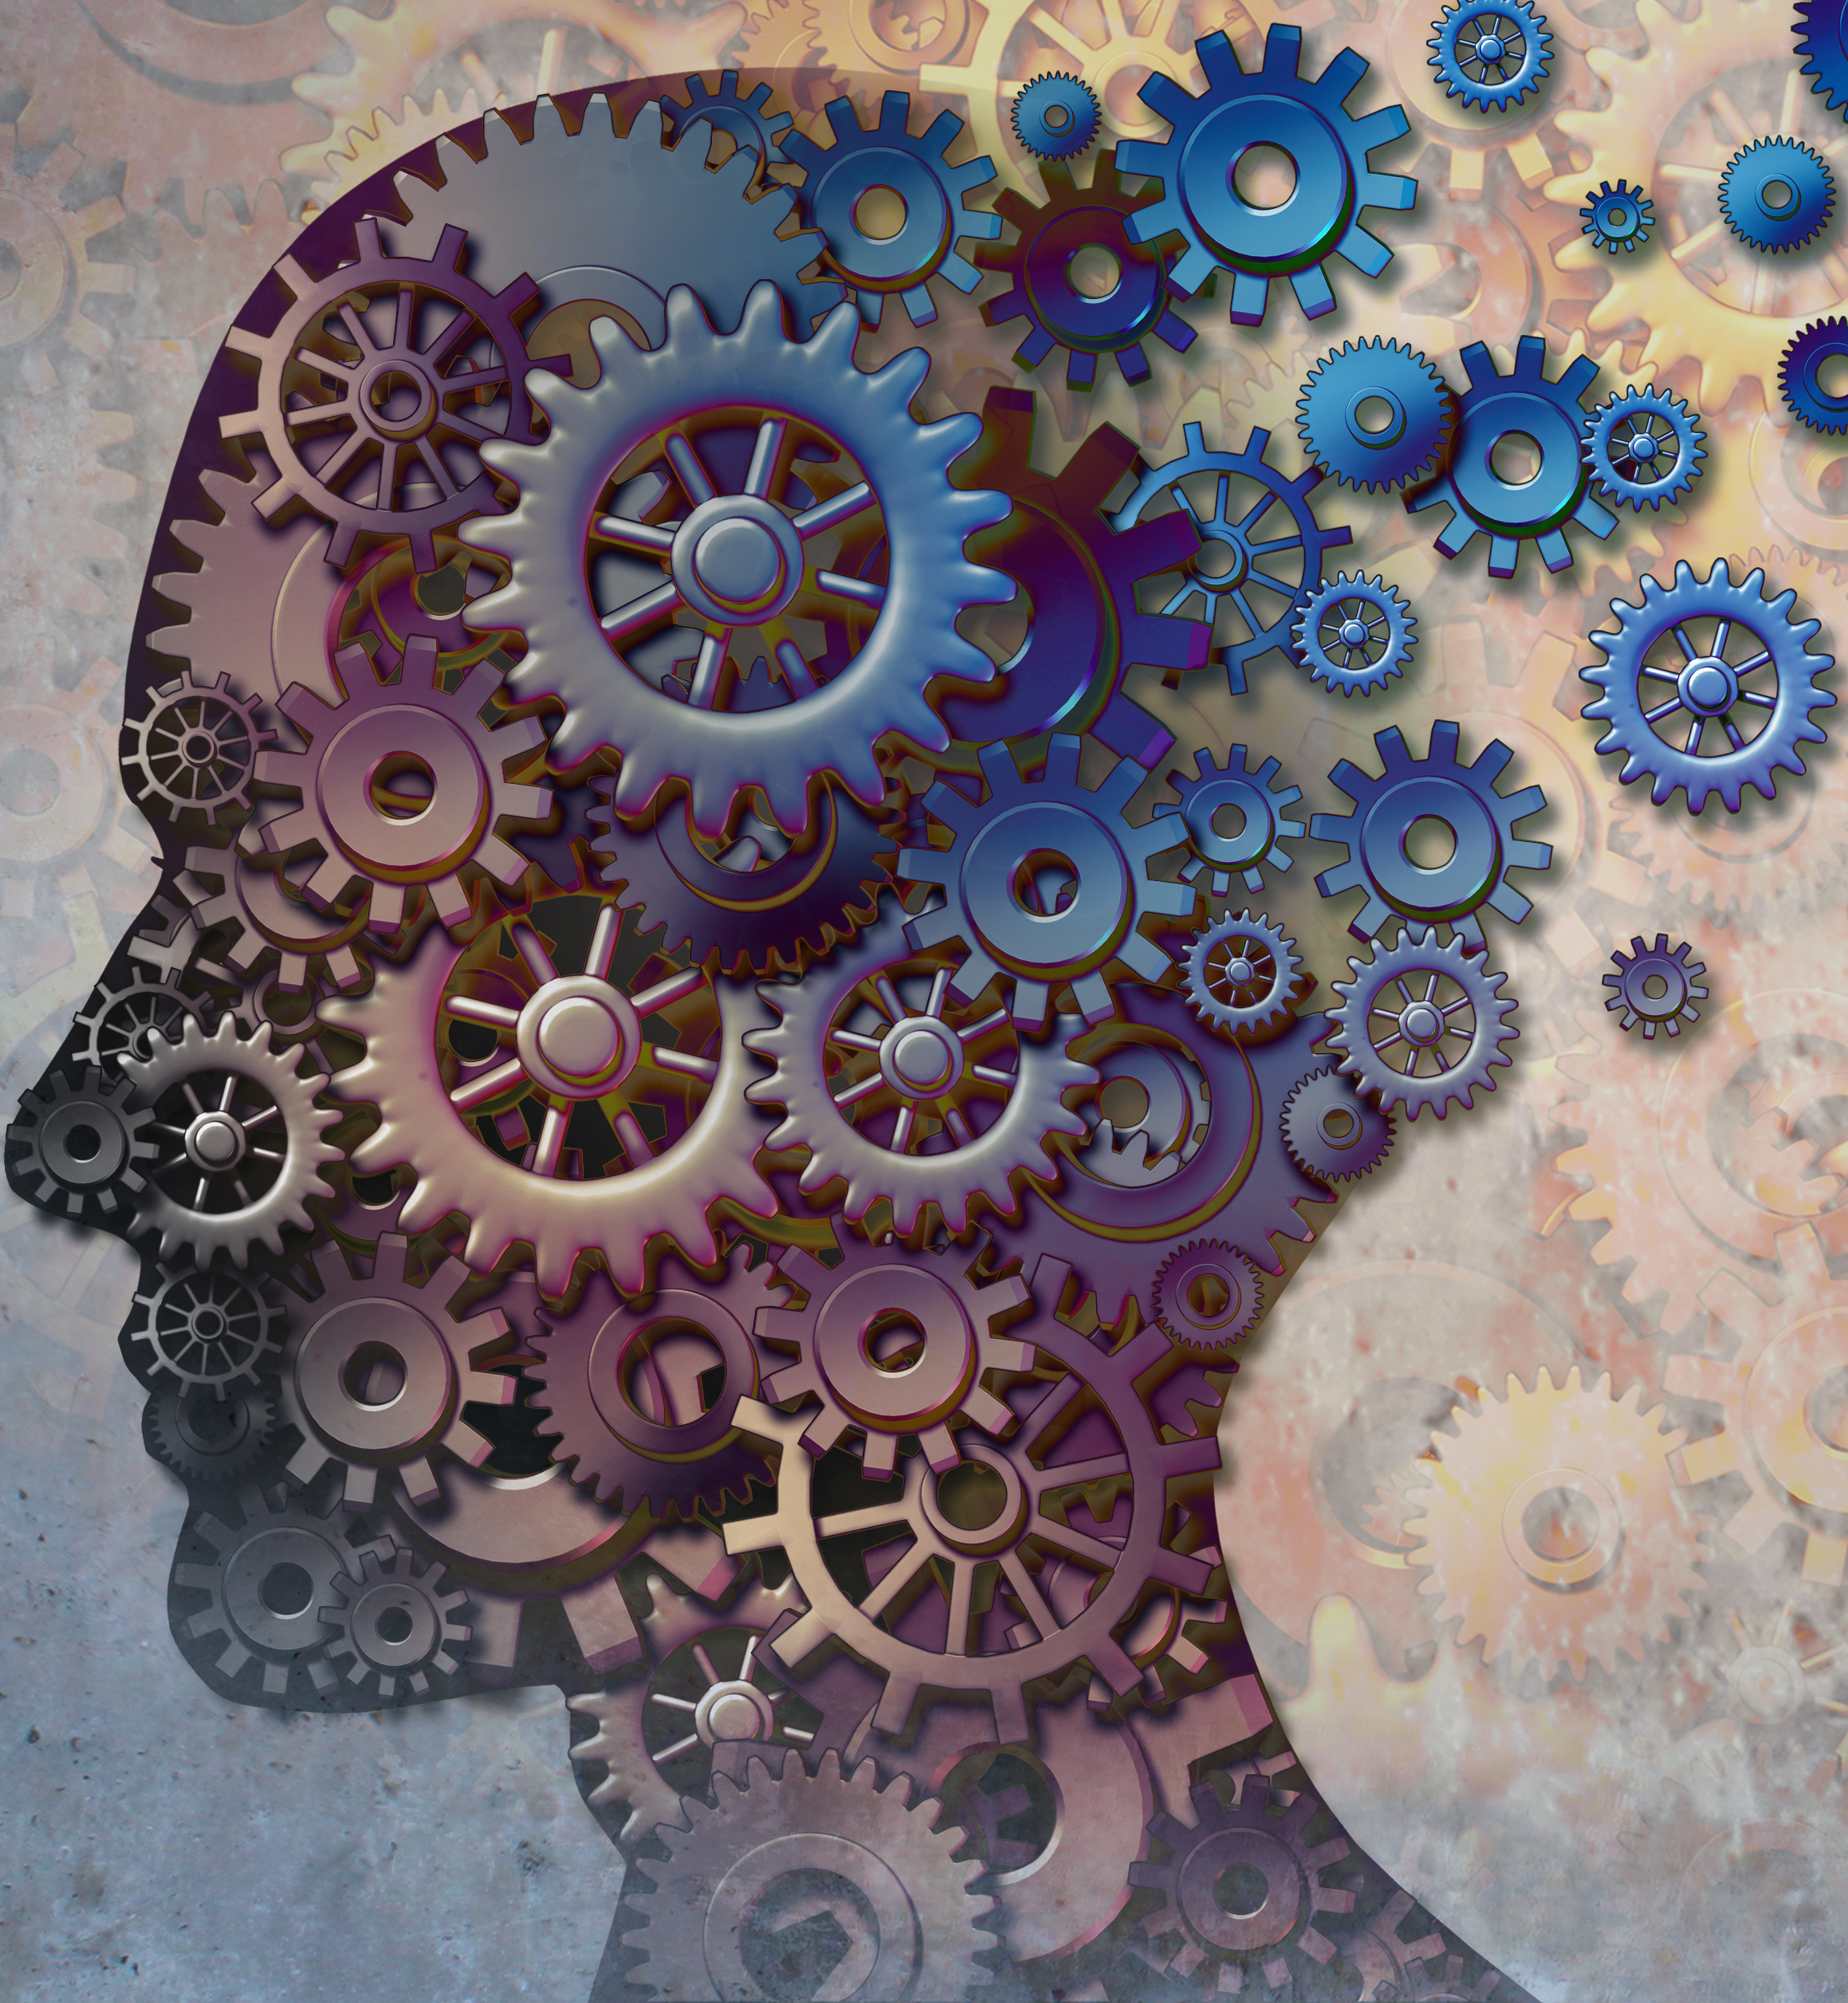
What is ARTIFICIAL/AUGMENTED INTELLIGENCE?
Artificial Intelligence (A.I.) is non-human intelligence that has been engineered rather than one that has evolved naturally.
Artificial intelligence research is research carried out in pursuit of this goal.
Pragmatically speaking, A.I. is “computers carrying out tasks that only humans can usually do”.
Augmented Intelligence is human intelligence that is supported or enhanced by machine intelligence.

Slide 15
The Data SCIENCE “Workflow”
Objective/
Rationale
Utilization and Decision Support
Data Collection
Data Exploration
Infrastructure and Data Management
Data Preparation
Modeling and Analysis
Communication

Slide 16
The Data Science “Workflow”
Objective/
Rationale
Utilization and Decision Support
Data Collection
Data Exploration
Infrastructure and Data Management
Data Preparation
Modeling and Analysis
Communication

Slide 17
Life After Analysis
When an analysis or model is ‘released into the wild’, it can take on a life of its own.
Analysts may eventually have to relinquish control over dissemination. Results may be misappropriated, misunderstood, or shelved. What can the analyst do to prevent this?
Finally, because of analytic decay, it’s important to view the last analytical step NOT as a static dead end, but rather as an invitation to return to the beginning of the process.

Slide 18
Data Science Ecosystem
Data analysis is a team sport, with team members needing a good understanding of both data and context
data management
data preparation
analysis
communications
Even slight improvements over a current approach can find a useful place in an organization – data science is not solely about Big Data and disruption!

Slide 19
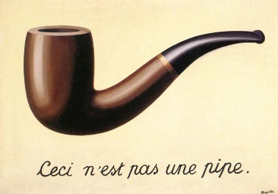
Representation
A representation is an object that stands in for another object.
A representation may or may not physically resemble the object it represents.
Representations of the world help us to understand, navigate and manipulate the world.

Slide 21
Thinking in Systems Terms
In order to understand how various aspects of the World interact with one another, we need to carve out chunks corresponding to the aspects and define their boundaries.
Working with other intelligences requires shared understanding of what is being studied.
A system is made up of objects with properties that potentially change over time. Within the system we perceive actions and evolving properties leading us to think in terms of processes.

Slide 22
Thinking in Systems Terms
Objects themselves have various properties. Natural processes generate (or destroy) objects, and may change the properties of these objects over time.
We observe, quantify, and record particular values of these properties at particular points in time.
This generates data points, capturing the underlying reality to some degree of accuracy and error (biased or unbiased).

Slide 23
Identifying Gaps in Knowledge
A gap in knowledge is identified when we realize that what we thought we knew about a system proves incomplete (or false).
This might happen repeatedly, at any moment in the process:
data cleaning
data consolidation
data analysis
The solution is to be flexible. When faced with such a gap, go back, ask questions, and modify the system representation.

Slide 24
Conceptual Models
Exercise:
assume that an acquaintance has just set foot in your living space for the first time.
you are on the phone with them but not currently at home.
explain to them how to go about preparing a cup of sugar.
Conceptual models are built using methodical investigation tools
diagrams
structured interviews
structured descriptions
etc.

Slide 25
Relating the Data to the System
Is the data which has been collected and analyzed going to be of any use when it comes to understanding the system?
This question can only be answered if we understand:
how the data is collected
the approximate nature of both data and system
what the data represents (observations and features)
Is the combination of system and data sufficient to understand the aspects of the world under consideration?

Slide 26
The Need for Ethics
Formerly: “Wild West” mentality to data collection (and use). Whatever wasn’t technologically forbidden was allowed.
Now: professional codes of conduct are being devised for data scientists (outline responsible ways to practice data science).
Additional responsibility for data scientists; but also protection against being hired to carry out questionable analyses.
Does your organization have a code of ethics for its data scientists? For its employees?

Slide 27
What Are Ethics?
Broadly speaking, ethics refers to the study and definition of right and wrong conducts:
“not […] social convention, religious beliefs, or laws”. (R.W. Paul, L. Elder)
Influential Western ethical theories:
Kant's golden rule (do onto others…), consequentialism (the ends justify the means), utilitarianism (act in order to maximize positive effect), etc.
Influential Eastern ethical theories:
Confucianism, Taoism, Buddhism (?), etc.

Slide 28
WHAT ARE ETHICS?
[OCAP® is a registered trademark of the First Nations Information Governance Centre (FNIGC), fnigc.ca/OCAP]
First Nations Principles of OCAP®:
Ownership cultural knowledge, data, and information is owned by First Nations communities
Control First Nations communities have the right to control all aspects of research and information management that impact them
Access First Nations communities must have access to information and data about themselves no matter where it is held
Possession First Nations communities must have physical control of relevant data
Notes:
Email story? Smart phone story?

Slide 29
Ethics in the Data Context
[University of Virginia, Centre for Big Data Ethics, Law, and Policy]
Data ethics questions:
Who, if anyone, owns data?
Are there limits to how data can be used?
Are there value-biases built into certain analytics?
Are there categories that should not be used in analyzing personal data?
Should some data be publicly available to all researchers?
Analytically, the general is preferred to the anecdotal – decisions made on the basis of machine learning and A.I. (security, financial, marketing, etc.) may affect real beings in unpredictable ways.
Notes:
Email story? Smart phone story?

Slide 30
Best Practices
“Do No Harm”: data collected from an individual should not be used to harm the individual.
Informed Consent:
Individuals must agree to the collection and use of their data
Individuals must have a real understanding of what they are consenting to, and of possible consequences for them and others
Respect “Privacy”: excessively hard to maintain in the age of constant trawling of the Internet for personal data.

Slide 31
Best Practices
Keep Data Public: data should be kept public (all? most? any?).
Opt-In/Opt-Out: Informed consent requires the ability to opt out.
Anonymize Data: removal of id fields from data prior to analysis.
“Let the Data Speak”:
no cherry picking
importance of validation (more on this later)
correlation and causation (more on this later, too)
repeatability

Slide 32
Model Assessment and Validity
Models should be current, useful, and valid.
Data can be used in conjunction with existing models to come to some conclusions, or can be used to update the model itself.
At what point does one determine that the current data model is out-of-date or is not useful anymore?
Past successes can lead to reluctance to re-assess and re-evaluate a model.

